Slide 1
WASTE MANAGEMENT
PIP2001 Capstone Project
Review-0
Batch Number:207
Under the Supervision of,
Dr . Sukruth Gowda MA
Assistant Professor senior scale
School of Computer Science and Engineering
Presidency University
Student Name | Roll Number
P. Pavan Kumar Reddy | 20211CSE0195
K. Sai Charan Reddy | 20211CSE0743
T. Vikram Simha | 20211CSE0179
Name of the HoD: Dr . Asif Mohamed B H
Name of the Program Project Coordinator: Dr . Amarnath
Name of the School Project Coordinators: Dr. Sampath A K / Dr. Abdul Khadar A / Mr. Md Ziaur Rahman

Slide 2
Content
Problem Statement
Analysis of Problem Statement
Timeline of the Project
References

Slide 3
Problem Statement Number:PSCS145
Organization: Cognizant
Category (Hardware / Software / Both) : Software
Problem Description : Households generate degradable (food) and non- degradable (plastics, glass etc.) at a massive scale on a daily basis.
Degradable waste can be readily made into compost with simple tools while non-degradable waste could be collected and deposited at the regional centers who recycle the material. An on- demand service would be helpful for the public to manage their plastic waste conveniently. This reduces landfills to major extent.

Slide 4
Analysis of Problem Statement
Technology Stack Components: Full stack Web Dev
Frontend:
React.js
HTML & CSS
JavaScript
Backend:
Node.js
Express.js
Database
MongoDB (NoSQL)
MySQL (SQL)

Slide 5
Analysis of Problem Statement (contd...)
Software and Hardware Requirements:
Operating System: Windows 10, macOS, Linux
Frameworks: React.js, Node.js, Flask
Database: MongoDB, MySQL
Version Control: Git
Web Hosting: AWS/ Firebase

Slide 6
Analysis of Problem Statement (contd...)
Functionalities:
Tracking the amount of waste generated from each house and each municipality.
Methods to dispose of biodegradable and non-bio-degradable wastes efficiently.
Maintenance of a completely robust and efficient database to track all the information on waste generation and disposal.
Managers of dumps and recycling factories can publish their possibilities or needs in acquiring a certain amount of waste for storing or recycling.
.

Slide 7
Analysis of Problem Statement (contd...)
A grievance system for people to submit any kinds of suggestions/problems regarding waste management in their locality.
Benefits of the proposed system: The waste management system provides an efficient portal for monitoring, collection, and disposal of wastes from each house and locality. Moreover, the data helps the authorities to take necessary actions beforehand.

Slide 8
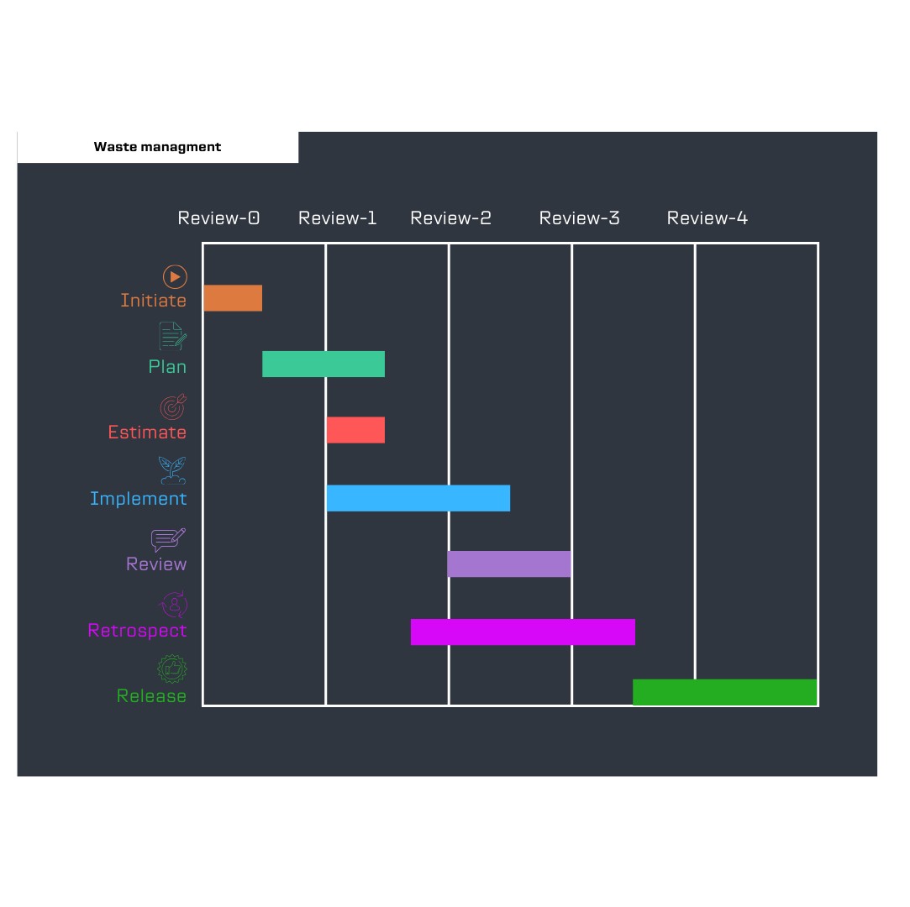
Timeline of the Project (Gantt Chart)

Slide 9
References (IEEE Paper format)
Kaza, Silpa Yao, Lisa C. Bhada-Ta ta, Pe ri naz Van Woer de n, Fra nk , What a Waste 2.0: A Global Snapshot of Solid Waste Management to 2050, 2018.
Karthik, M., Sreevidya, L., Nithya Devi, R., Thangaraj, M., Hemalatha, G., and R. Yamini., "An efficient waste management technique with IoT based smart garbage system," Materials Today: Proceedings, vol. 80, pp. 3140-3143, 10 june 2023
Mittal, G., Yagnik, K.B., Garg, M., Krishnan, N.C., "SpotGarbage: smartphone app to detect garbage using deep learning," in the 2016 ACM International Joint, 2016.

Slide 10


